Slide 1


Addressing the Under-translation Problem from the Entropy Perspective
Yang Zhao, Jiajun Zhang, Chengqing Zong, Zhongjun He, and Hua Wu
National Laboratory of Pattern Recognition, Institute of Automation, CAS, Beijing, China
Baidu Inc., Beijing, China
{yang.zhao, jjzhang, cqzong}@nlpr.ia.ac.cn, {hezhongjun,wu_hua} @baidu.com

Slide 2


Outline
Introduction
Motivation
Method Description
Experiential Results

Slide 3
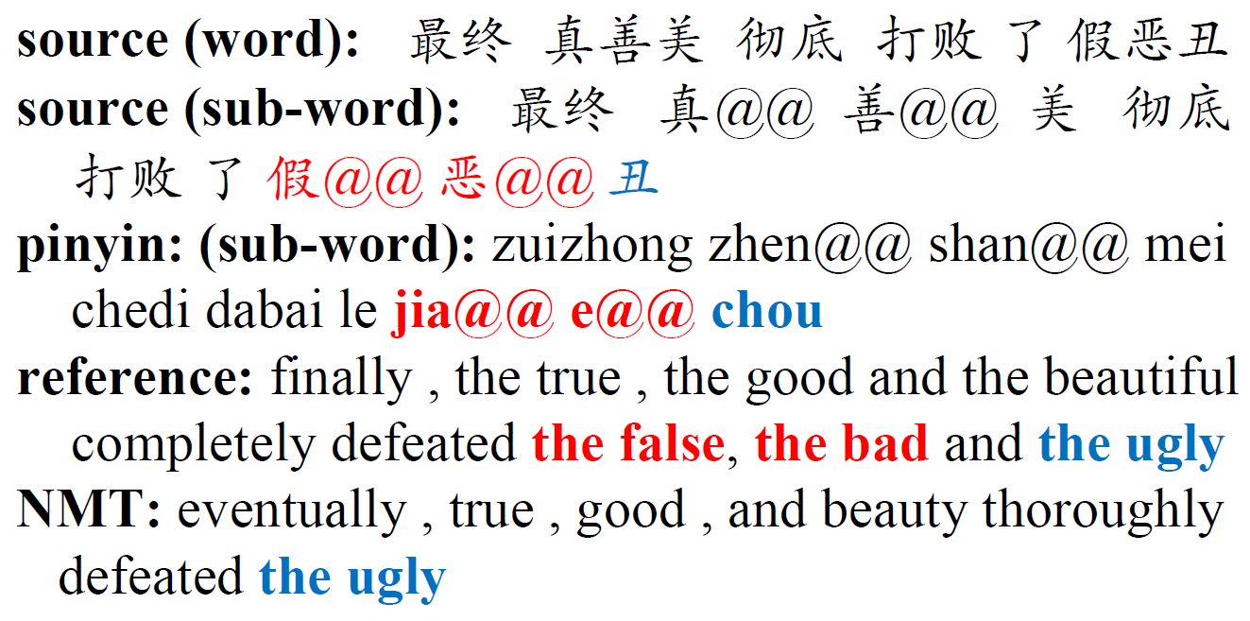
Neural Machine Translation (NMT)
Neural Machine Translation (NMT): an approach to machine translation by using a large artificial neural network.
Under-translation: some source words sometimes are mistakenly dropped by the neural Model.
Example to show the under-translation in NMT.

Slide 4
Current Solutions for Under-translation
The current methods study the problem in the model level.
Improving the attention mechanism
e.g., the coverage model (Tu et al. 2016; Mi et al. 2016)
Optimizing the hidden states of the encoder and decoder
e.g., the reconstructing model (Tu et al. 2017) and the modeling past and future method (Zheng et al. 2018).
Tu, Z.; Lu, Z.; Liu, Y.; Liu, X.; and Li, H. 2016. Coverage-based neural machine translation. In Proceedings of ACL 2016, 76–85.
Mi, H.; Sankaran, B.; Wang, Z.; and Ittycheriah, A. 2016. Coverage embedding model for neural machine translation. In Proceedings of EMNLP 2016, 955–960.
Tu, Z.; Liu, Y.; Shang, L.; Liu, X.; and Li, H. 2017. Neural machine translation with reconstruction. In Proceedings of AAAI 2017.
Zheng, Z.; Zhou, H.; Huang, S.; Mou, L.; Dai, X.; Chen, J.; and Tu, Z. 2018. Modeling past and future for neural machine translation. TACL 145–157.

Slide 5
Our Motivation and Idea
In this work, we try to answer the following two questions:
Why: Why are some source words missed while the others are not?
How: If we can know that some certain kinds of words are more likely to be missed, how can we reduce the risk of under-translations of these words?

Slide 6
Our Contributions
Answer to Why：
We find that source words with larger translation entropy are more likely to be dropped by the neural model.
Answer to How:
We propose a coarse-to-fine framework to address the under-translation problem of high-entropy words.

Slide 7
Observation and Motivation
Definition (translation entropy): Assume a word contains candidate translations, each of which has a probability , the translation entropy for this word can be calculated

Slide 8
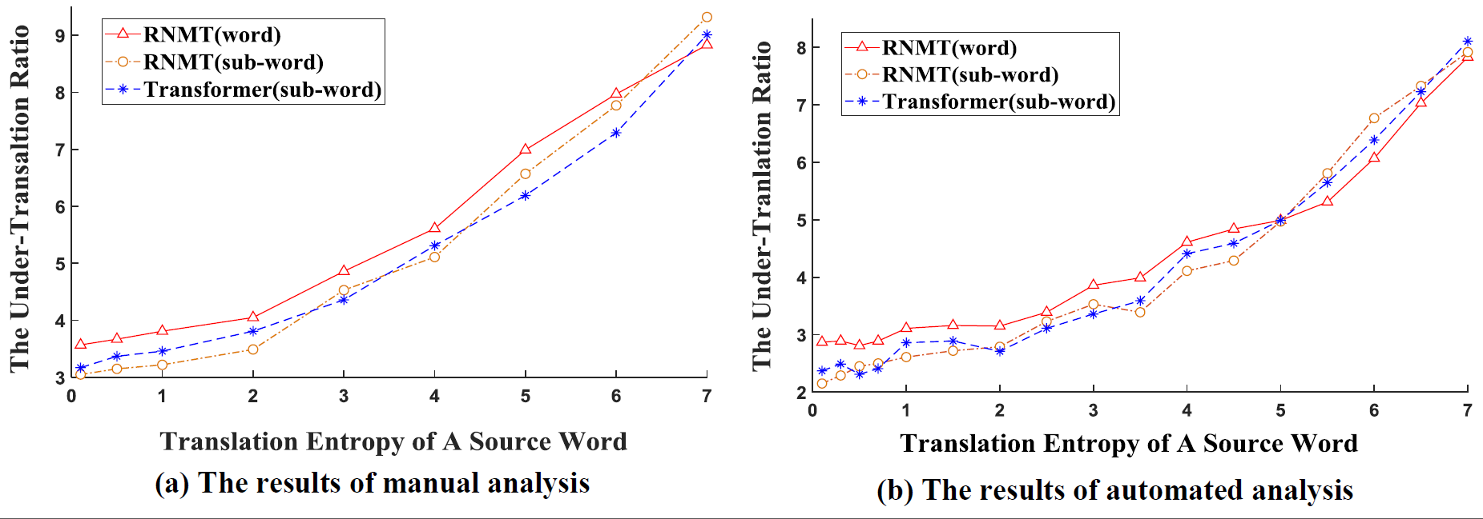
Observation and Motivation
The relationship between the ratio of under-translation (%) (y axis) and translation entropy (x axis).

Slide 9
Method Description
We propose a coarse-to-fine framework to address this problem
In coarse-grained phase, we construct the pseudo target sentences to reduce the entropy.
In fine-grained phase, the derived pseudo sentences are utilized to improve the neural model.

Slide 10
Coarse-grained Phase
Assume word is a high-entropy word, contains four candidates
three pairs in dataset:
In m-th pair,
In n-th pair,
In p-th pair,
Construction method (a):
replace by stoken4s1.
keep the others unchanged.

Slide 11
Coarse-grained Phase
Training data will change by
where X and Y are the original source and target sentences.
Z is the derived pseudo target sentence.

Slide 12
Fine-grained Phase
Our task is to improve the fine-grained neural model with pseudo sentences Z.
Pre-training method
for pre-training
for fine-tuning

Slide 13
Fine-grained Phase
Multitask method
train neural model through two translation tasks:
the task from X to Y
the task from X to Z
The object function is redesigned by

Slide 14
Fine-grained Phase
Two-pass method
Translation step
the standard NMT framework
Input X , output Z (X Z)
we can get predicted translation distribution

Slide 15
Fine-grained Phase
2. Disambiguation step
1) disambiguation vector
The embedding of special token
The context vector
The hidden states of decoder
2) Assignment score
3) Disambiguation probability distribution
Object function:
Translation step
Disambiguation step

Slide 16
Experimental Settings
Translation Task:
Chinese-to-English (CH-EN),
English-to-Japanese (EN-JA)
English-to-German(EN-DE)
Translation Models
RNMT: LSTM layers as encoder and decoder.
RNMT+coverage: The coverage model in RNMT.
Transformer: self-attention mechanism..
X+pre_train, X+multitask, and X+two_pass: our method

Slide 17
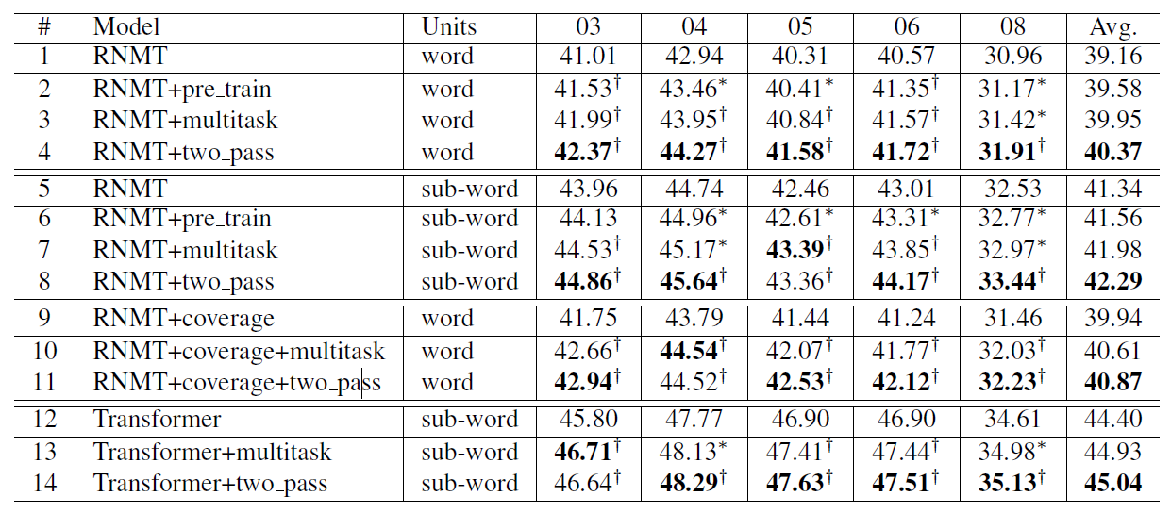
Experimental Results
The main results of CH-EN translation
RNMT（word）vs. RNMT+two_pass(word): +1.21
RNMT（sub-word）vs. RNMT+two_pass(sub_word): +0.95
Coverage (word) vs. RNMT+coverage +two_pass(word): +0.93
Transformer(sub-word) vs. Transformer+two_pass(sub-word) : +0.64

Slide 18
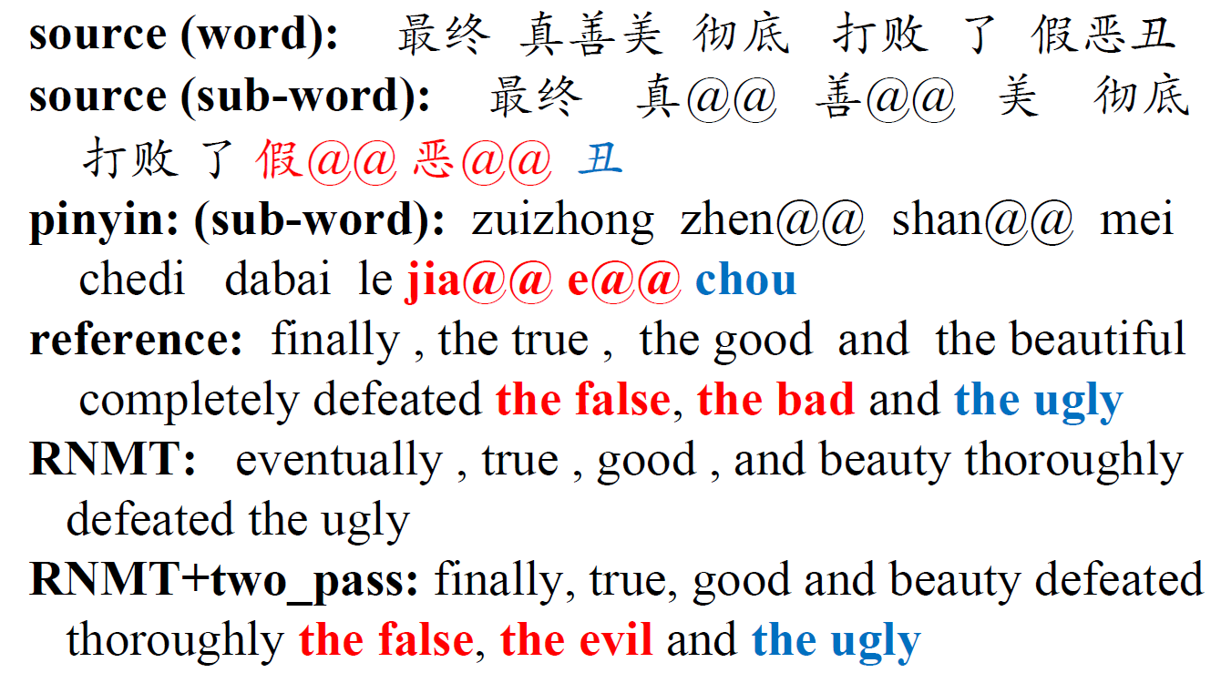
Case

Slide 19
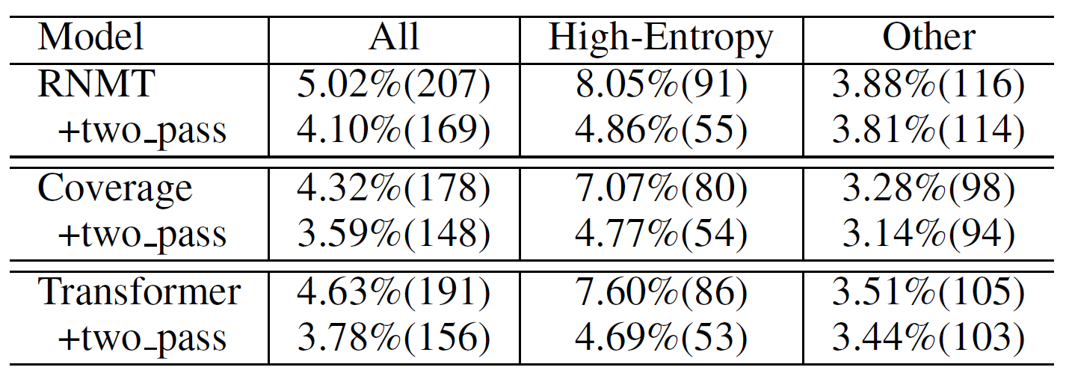
Statistics of Under-translation
The under-translation ratio (number) of different methods.
Our methods most effective to reduce the under-translation cases of high-entropy words.
Our methods and coverage model are complementary

Slide 20
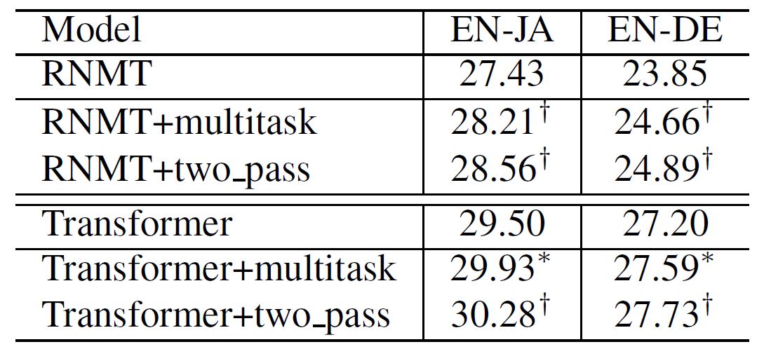
Results on EN-JA and EN-DE Translation
The results on EN-JA and EN-DE translation.
Our methods are also effective on EN-JA and EN-DE

Slide 21
Conclusions
We find that source words with larger translation entropy are more likely to be dropped.
We propose a coarse-to-fine framework to address this problem.

Slide 22

Thanks

